Slide 1

Gelato Foreverrr
2101664624 - Anindhito Irmandharu
2101651786 - Rio Rafelino
2101709244 - Aelwen
2101711860 - Dania Ester Felicia Siregar
2101654352 - Alldo Kurniawan

Slide 2
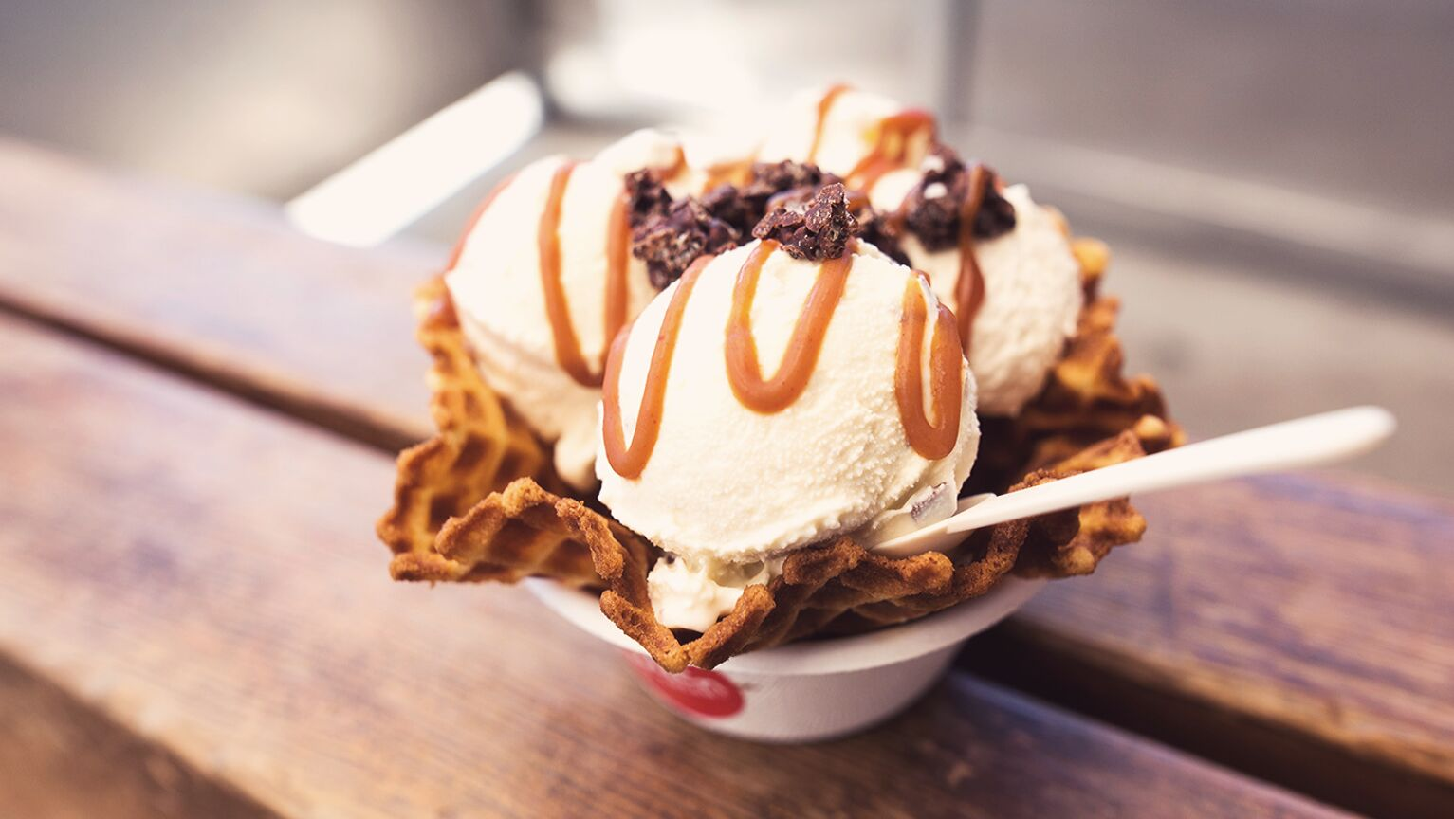
ICE CREAM GELATO
ABOUT OUR COMPANY
Ice Cream Gelato is startup company where we would like all people to taste the true value of gelato.

Slide 3



Customer Target
ADULTS
INSTAGRAMERS
KIDS

Slide 4
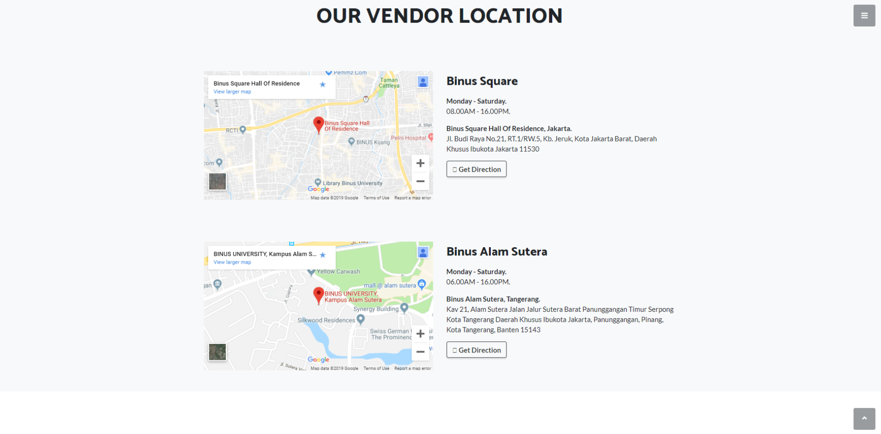

Slide 5
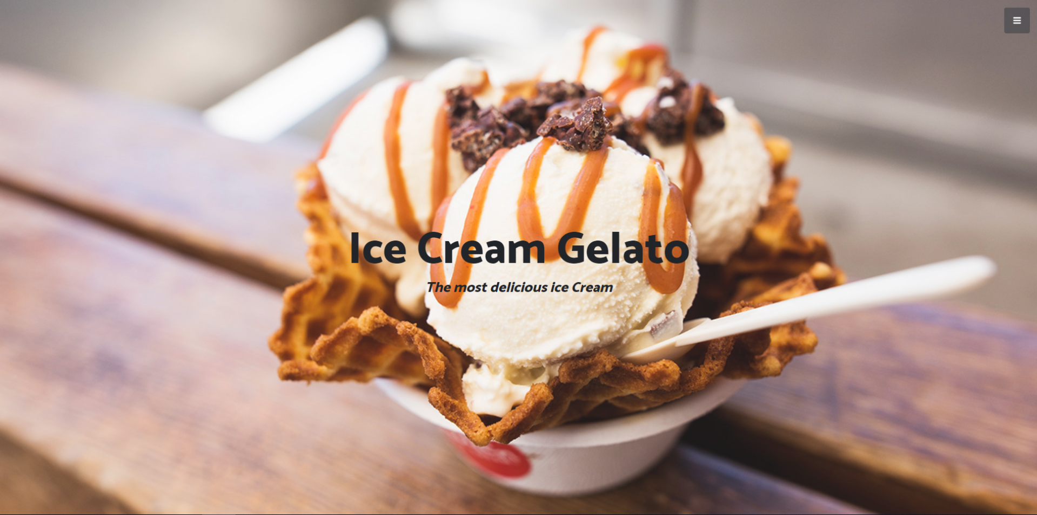
HOME
PAGE

Slide 6
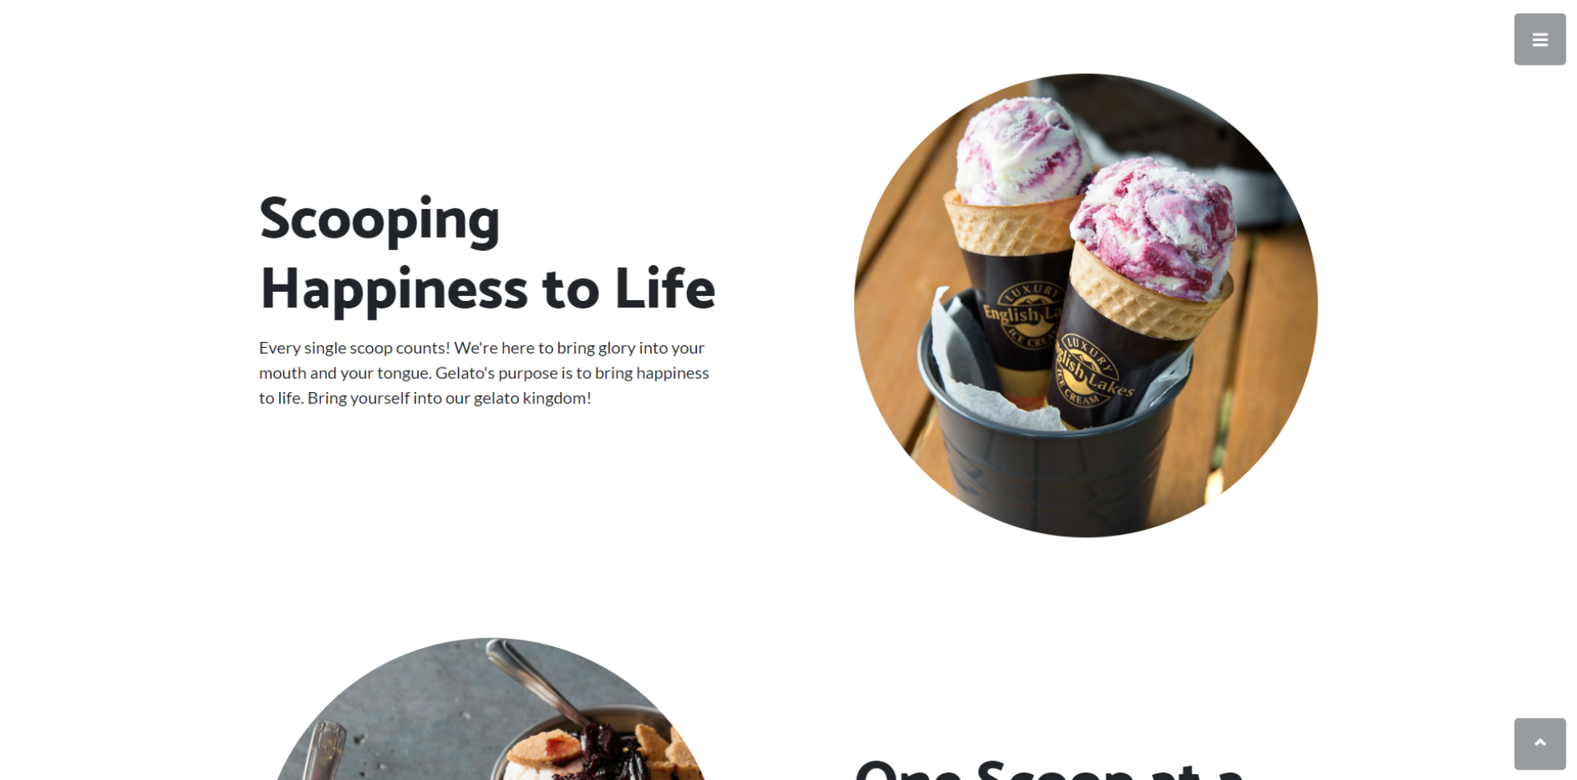

Slide 7
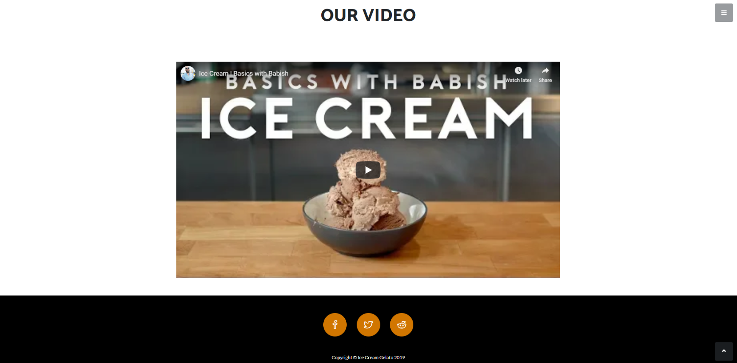

Slide 8
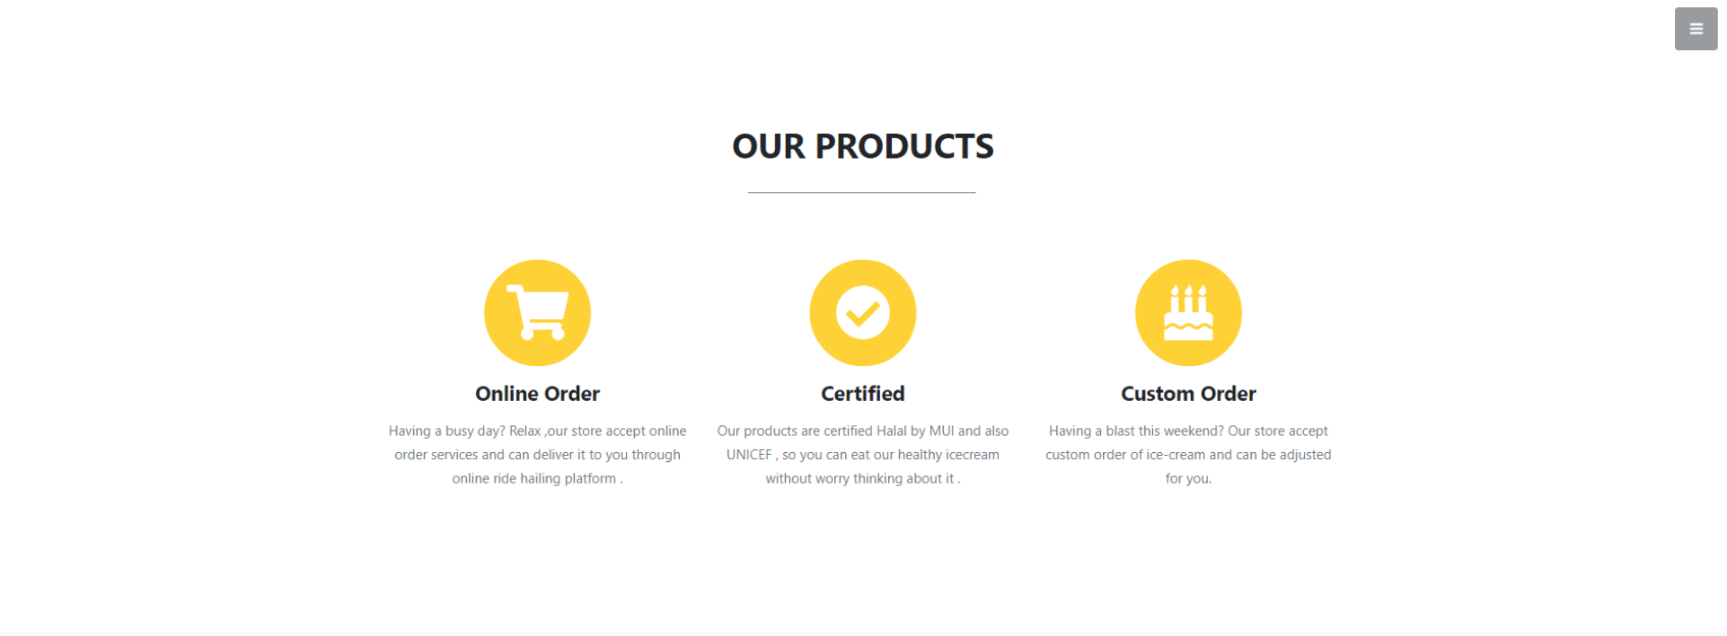
PRODUCT PAGE

Slide 9
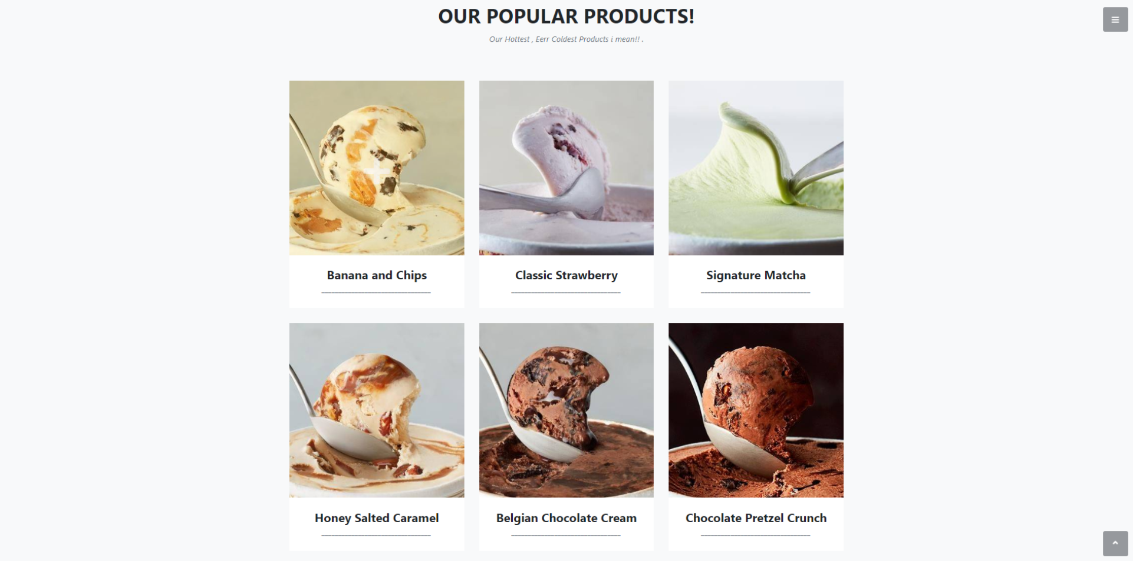

Slide 10
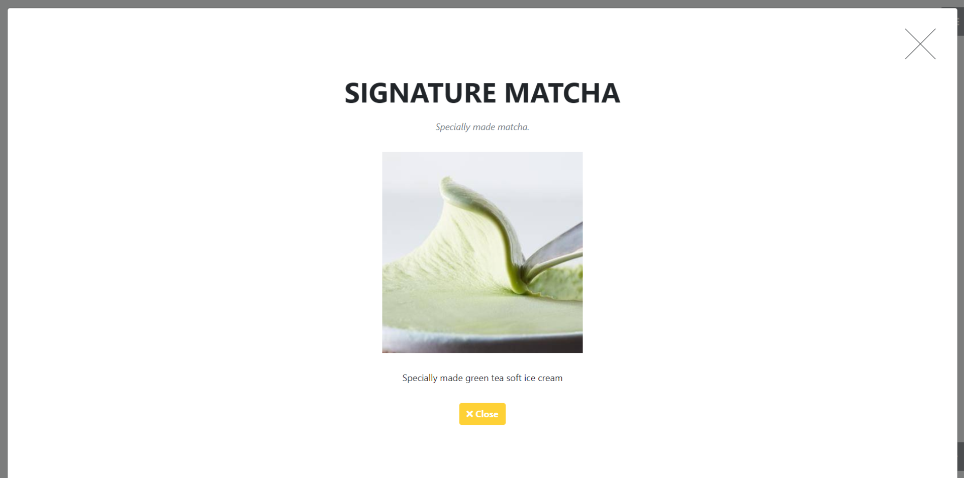

Slide 11

ABOUT
PAGE

Slide 12
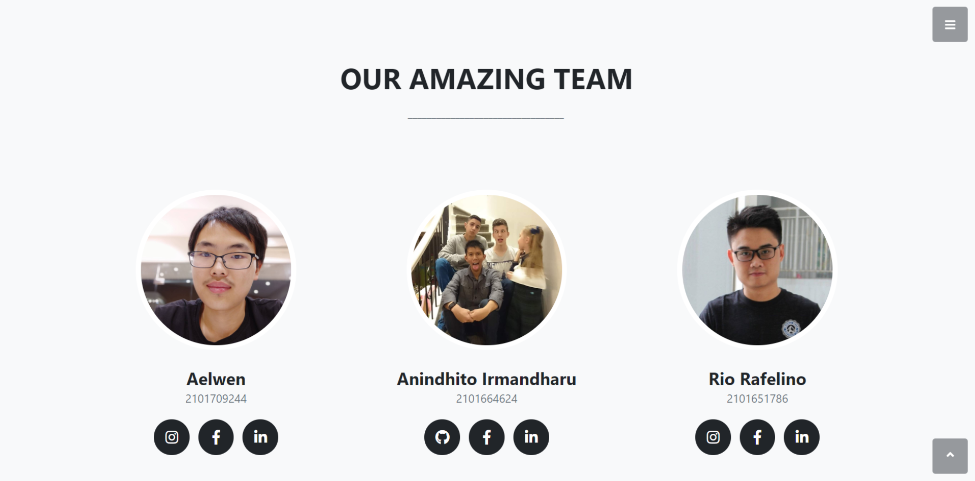

HYPERLINK

